Slide 1
An Introduction to Health and the US Health Care System
Lecture 1

Slide 2
Flow of Dollars and Services,
U.S. Health Care System, pre WWII
Patients/Consumers
Payments
Providers (doctors, hospitals)
Medical care services
Donations
Payments
Charity

Slide 3
Flow of Dollars and Services,
Canada, Europe and Other Single Payer Systems
Patients/Consumers
Providers (doctors, hospitals)
Medical care services
Taxes
Payments
Government

Slide 4
Flow of Dollars and Services,
1967-2013
Insurance companies
Employers
Premiums
Premiums
Payments
Patients/
Consumers
Out of pocket payments
Providers (doctors, hospitals)
Taxes
Medical care services
Medical care services
Payments
Donations
Military medical care
Charity
Taxes
Medicare/Medicaid Payments
Government

Slide 5
Flow of Dollars and Services,
After ACA
Insurance companies
Employers
Premiums
Premiums
Insurance exchanges
Premiums
Payments
Premiums
Premiums
Patients/
Consumers
Out of pocket payments
Providers (doctors, hospitals)
Taxes
Subsidies
Medical care services
Medical care services
Payments
Donations
Military medical care
Charity
Taxes
Medicare/Medicaid Payments
Government

Slide 6
Origination of Medicare and Medicaid
President Lyndon B. Johnson 1965 signed the
Medicare and Medicaid into law
First major social insurance system
Medicaid—low income
Medicare—elderly, 65 or older

Slide 7
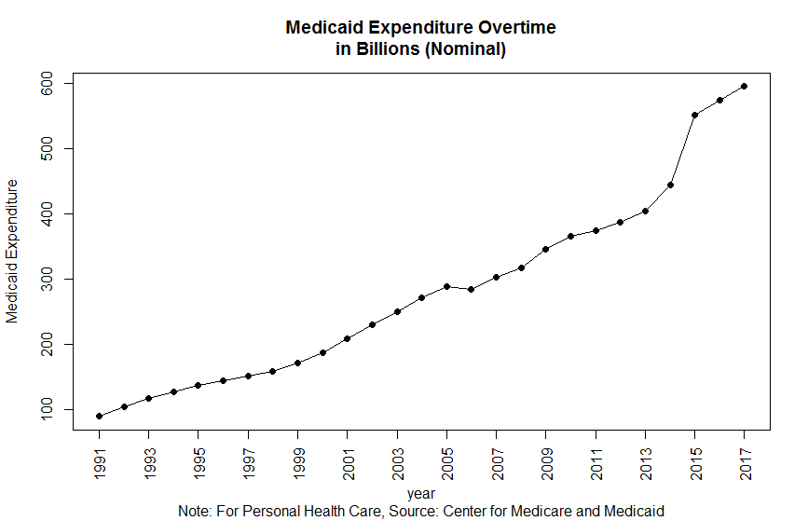

Slide 8
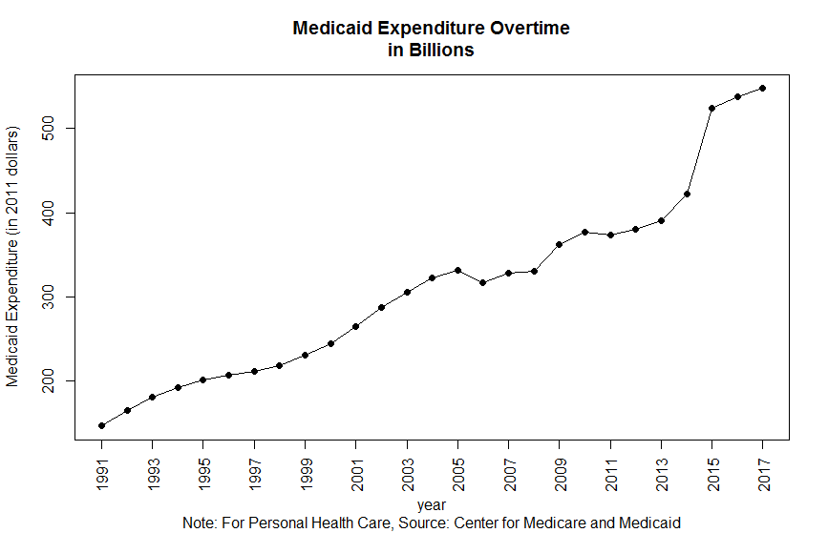

Slide 9
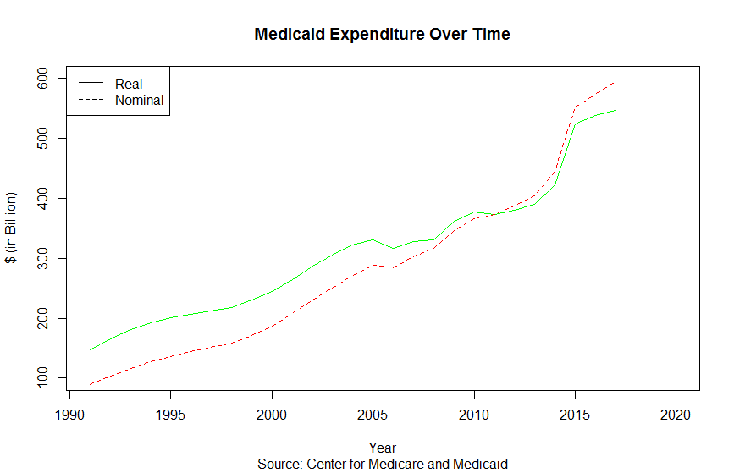

Slide 10
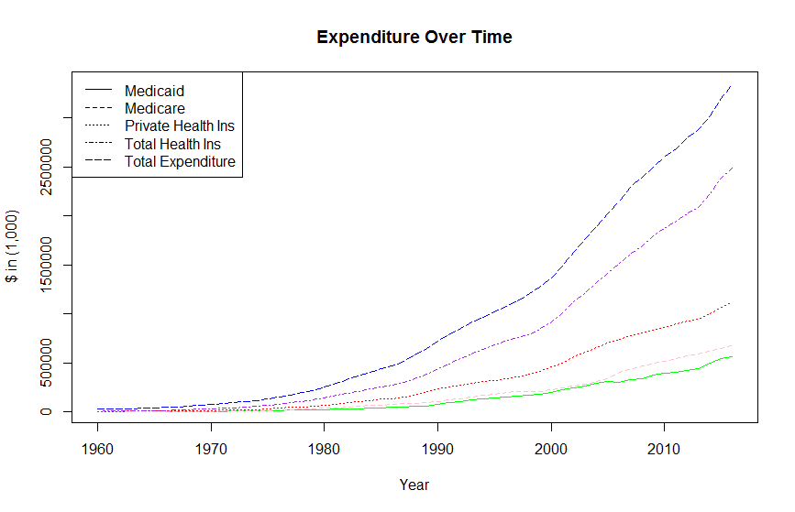

Slide 12
Spending = Price *Quantity
 | Percent change in prices from previous year
 | All Consumer Items | All Medical Care | Medical Care Services
1960 | 1.70 | 3.70 | 4.30
1970 | 5.70 | 6.60 | 7.00
1980 | 13.50 | 11.00 | 11.30
1990 | 5.40 | 9.00 | 9.30
2000 | 3.40 | 4.10 | 4.30
2005 | 3.40 | 4.20 | 4.80
2009 | -0.40 | 3.20 | 3.20
2013 | 1.50 | 2.50 | 3.10
Source: BLS

Slide 15
Where the Money is Spent
 | Hospital | Professional Services (physicians, clinical services, dental) | Prescription Drugs | Home Health Care, Nursing and Other Personal care | Durable and Non Durable Medical Equipment
1960 | 32.8% | 29.3% | 9.8% | 4.8% | 8.6%
1970 | 36.3% | 26.4% | 7.3% | 7.5% | 6.7%
1980 | 39.3% | 25.3% | 4.7% | 10.2% | 5.4%
1990 | 34.6% | 28.7% | 5.6% | 11.3% | 5.0%
2000 | 30.2% | 28.3% | 8.8% | 13.3% | 4.1%
2013 | 32.1% | 26.6% | 9.3% | 13.1% | 3.4%
 | Government Administration | Net Cost of Health Insurance (Premiums collected-benefits paid) | Government Public Health Activities | Research | Structures and Equipment
1960 | 0.2% | 3.7% | 1.4% | 2.5% | 6.8%
1970 | 1.0% | 2.5% | 1.8% | 2.6% | 7.8%
1980 | 1.1% | 3.6% | 2.5% | 2.1% | 5.7%
1990 | 1.0% | 4.4% | 2.8% | 1.8% | 5.0%
2000 | 1.2% | 4.7% | 3.1% | 1.8% | 4.4%
2013 | 1.3% | 5.9% | 2.6% | 1.6% | 4.0%
Source: Centers for Medicare & Medicaid Services

Slide 16
Who Pays?
 | 1960 | 1970 | 1980 | 1990 | 2000 | 2013
Total National Health Expenditures in $ Billions (nominal) | $27.40 | $74.90 | $255.80 | $724.30 | $1,378.00 | $2,919.10
Percent of total NHE paid by:
Out of pocket | 48% | 33% | 23% | 19% | 15% | 12%
Health Insurance | 27% | 42% | 56% | 61% | 67% | 72%
Private Health Insurance | 21% | 21% | 27% | 32% | 33% | 33%
Medicare | 0% | 10% | 15% | 15% | 16% | 20%
Medicaid | 0% | 7% | 10% | 10% | 15% | 15%
Federal | 0% | 4% | 6% | 6% | 8% | 9%
State and Local | 0% | 3% | 4% | 4% | 6% | 7%
Other Gov’t Insurance Programs | 6% | 4% | 4% | 3% | 3% | 4%
Other Third Party Payers/Public Health | 16% | 14% | 14% | 13% | 12% | 11%
Investment | 9% | 10% | 8% | 7% | 6% | 6%
Source: Centers for Medicare & Medicaid Services
Notes:
CMS programs show as percent of total NHE. Federal and State percents do not sum to total percent due to rounding.

Slide 17
Who are insured?

Slide 18
Source: US Census Bureau, Current Population Survey

Slide 19
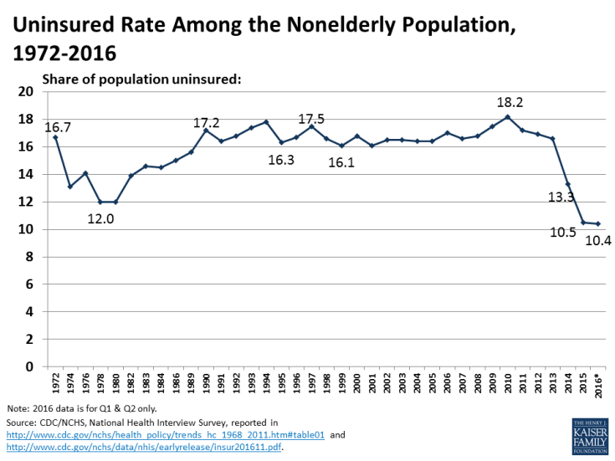

Slide 20
Insurance in 2012
Of the insured population:
54.9 % has employer sponsored private insurance
9.8 % individually purchased private insurance
16.4 % of the population has Medicaid
15.7 % of the population has Medicare
4.4 % of the population has military health care
(sums to >100 because of dual coverage)
Notes:
Some dual coverage

Slide 21
The Uninsured--2012
15.4 % of the population is uninsured, with 17.7% of the non-elderly population uninsured (47 million people).
Who are the uninsured?
14% are children under age 18
28% are ages 44-64
Of the 40 million uninsured ages 18-64, 70% are employed.

Slide 22
The Working Uninsured--2012
12.9% were self-employed and 87.1 worked for firms.
The largest group of uninsured workers were in service occupations and sales/office occupations
Many of the uninsured workers are full-time, full-year workers (54.4%). The others are part time, or part year workers.

Slide 25
What does all the spending buy us?

Slide 27
Infant Mortality Rates, United States
(Deaths per 1,000 live births)
Year | All | Male | Female | White | Black/African American
1940 | 47 | 52 | 42 | 43 | 73
1950 | 29 | 33 | 25 | 27 | 44
1960 | 26 | 29 | 23 | 23 | 44
1970 | 20 | 22 | 18 | 18 | 33
1980 | 13 | 14 | 11 | 11 | 21
1990 | 9 | 10 | 8 | 8 | 20
2000 | 7 | 8 | 6 | 6 | 14
2010 | 6 | 7 | 6 | 5 | 12

Slide 28
Deaths per 100,000 population, Selected Causes, United States
 | 1950 | 1960 | 1970 | 1980 | 1990 | 2000 | 2010
All causes | 1,446.0 | 1,339.2 | 1,222.6 | 1,039.1 | 938.7 | 869.0 | 747.0
Diseases of heart | 588.8 | 559.0 | 492.7 | 412.1 | 321.8 | 257.6 | 179.1
Cerebrovascular diseases | 180.7 | 177.9 | 147.7 | 96.2 | 65.3 | 60.9 | 39.1
Malignant neoplasms | 193.9 | 193.9 | 198.6 | 207.9 | 216.0 | 199.6 | 172.8
Influenza and pneumonia | 48.1 | 53.7 | 41.7 | 31.4 | 36.8 | 23.7 | 15.1
Chronic liver disease and cirrhosis | 11.3 | 13.3 | 17.8 | 15.1 | 11.1 | 9.5 | 9.4
Diabetes mellitus | 23.1 | 22.5 | 24.3 | 18.1 | 20.7 | 25.0 | 20.8
HIV disease | … | … | … | … | 10.2 | 5.2 | 2.6
Unintentional injuries | 78.0 | 62.3 | 60.1 | 46.4 | 36.3 | 34.9 | 38.0
Motor vehicle-related injuries | 24.6 | 23.1 | 27.6 | 22.3 | 18.5 | 15.4 | 11.3
Suicide | 13.2 | 12.5 | 13.1 | 12.2 | 12.5 | 10.4 | 12.1
Homicide | 5.1 | 5.0 | 8.8 | 10.4 | 9.4 | 5.9 | 5.3

Slide 29
Total health expenditure per capita, public and private, 2007

Slide 32
Quality of care?
High Quality
Prompt availability
Access to cutting-edge procedures and technology
Highly trained, skilled medical workforce
Low Quality
Low population health status, especially for minorities or low income groups
Barriers to access for those without adequate insurance coverage
Insufficient coordination among providers
Fragmented health care delivery system

Slide 33
Quality Quantified
Amenable deaths: deaths from certain causes that should not occur in the presence of timely and effective health care.
Bacterial infections
Treatable cancers
Diabetes
Cardiovascular and cerebrovascular disease
Complications of common surgical procedures
Some cases of ischemic heart disease

Slide 35
Capacity

Slide 36
Total Number of Active Physicians per 1,000 Persons, 1980 – 2011
Source: AHA.org Trend Watch Chartbook
But, 59.5 million people live in a primary medical care designated Health Profession Shortage Area. Population to primary care physician ratio of at least 3500:1.
Estimate of an additional 8,102 physicians needed.

Slide 37
To summarize, The U.S. Health Care system is characterized as follows:
Massive, complex system
Uncertainty is prevalent
Government plays a major role
Difficult allocation problem complicated by
scarcity
asymmetric knowledge
externalities

Slide 38
The Big Questions for this class
Do standard economic theories apply to this market?
How is the optimal quantity of health determined? How is health care allocated?
What is the role of insurance?
How has public policy and government intervention influenced the market and health outcomes?

